Slide 1
Adham Ashraf Saeed
Assignment 1 (SQL)

Slide 2
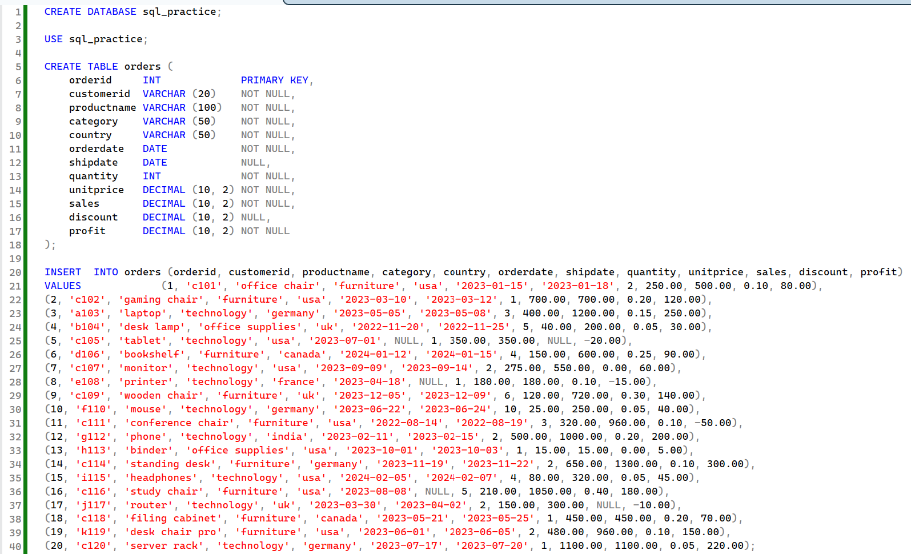
Access the following Database

Slide 3
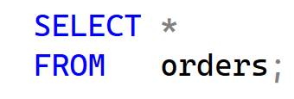
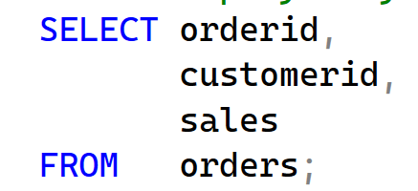
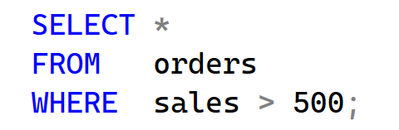
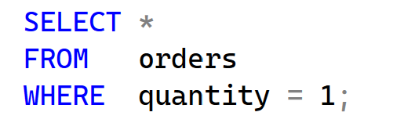
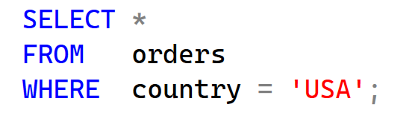
Basic Questions
Write a query to display all columns from the Orders table.
Display only the OrderID, CustomerID, and Sales columns.
Show all orders where Sales > 500.
Retrieve orders where Quantity = 1.
Display all orders where Country = 'USA' .

Slide 4
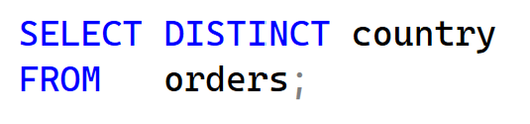
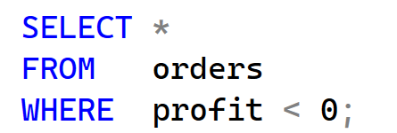
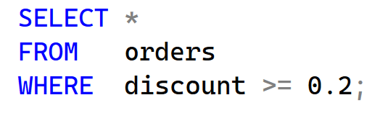
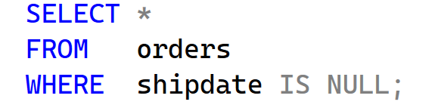
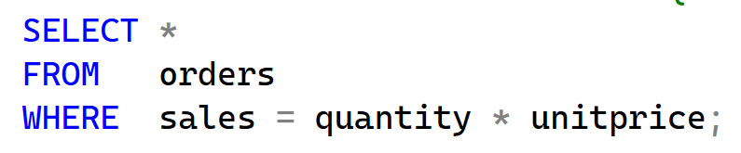
Basic Questions
List all distinct countries from the Orders table.
Show orders where Profit < 0.
Retrieve orders where Discount >= 0.2.
Display orders where ShipDate IS NULL.
Show orders where Sales = Quantity * UnitPrice

Slide 5
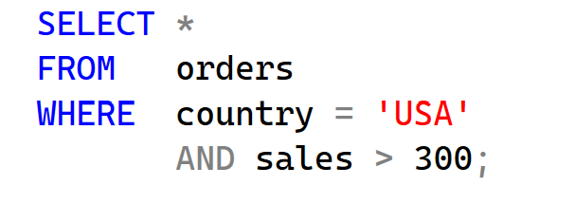
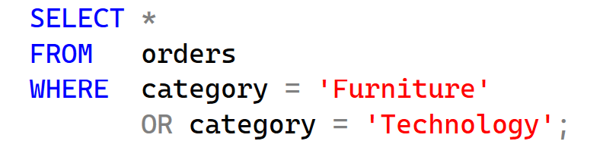
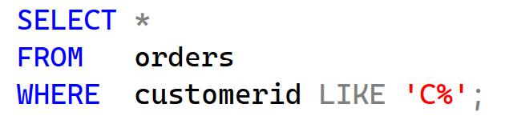
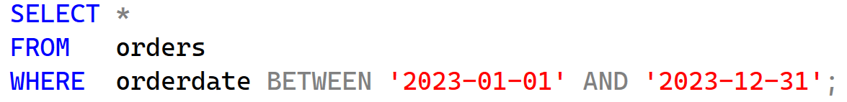
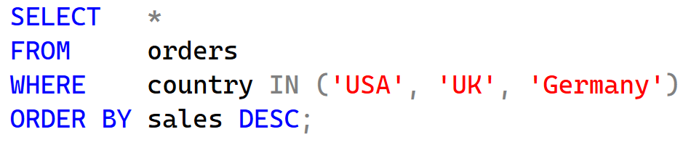
Intermediate Questions
Retrieve orders where Country = 'USA' AND Sales > 300.
Show orders where Category = 'Furniture' OR Category = 'Technology’ .
Find all orders where CustomerID starts with 'C' using LIKE.
Display orders where OrderDate is BETWEEN '2023-01-01’ AND '2023-12- 31’ .
Retrieve orders where Country IN ('USA' , 'UK' , 'Germany’), ordered by Sales DESC.

Slide 6
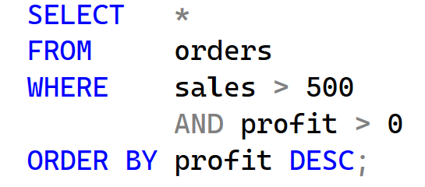
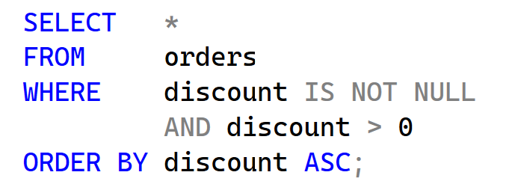
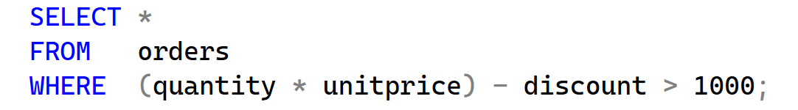
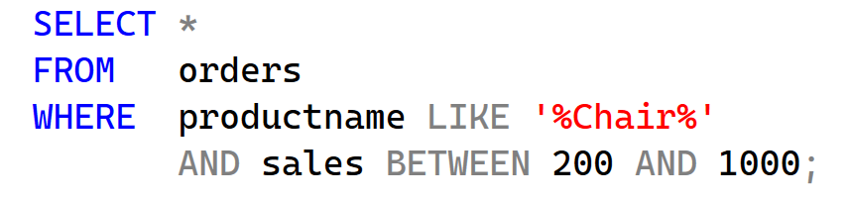
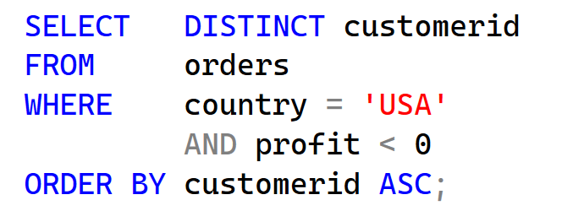
Advanced Questions
Show orders where Sales > 500 AND Profit > 0, ordered by Profit DESC.
Retrieve orders where Discount IS NOT NULL AND Discount > 0, sorted by Discount ASC.
Find orders where (Quantity * UnitPrice) - Discount > 1000.
Display orders where Product name contains 'Chair' , and Sales BETWEEN 200 AND 1000.
Retrieve distinct CustomerID values where Country = 'USA' AND Profit < 0, ordered alphabetically.

